Slide 1
Class : Other Search Domains 2
Joshua Durso-Finley Course code:
joshua.durso-finley@mail.mcgill.ca

Slide 2
Outline

Slide 3

Table of Contents
Constraint satisfaction problems
Notes:
‹#›

Slide 4
Recall: Optimization problems
Cost function we are trying to minimize (TSP, circuit board)
Constraints
Large state spaces O(n!),O(2^n)
We can start in one location then look locally until we settle on a good solution
Simulated Annealing
Notes:
‹#›

Slide 5
Constraint Satisfaction Problems
Solution that satisfies a set of constraints sudoku, crossword, scheduling
Few legal solutions exist. Generally 1 position.
Can be thought of as an optimization problem where the maximum value is obtained when all constraints are satisfied and zero elsewhere
Hard to optimize locally
Notes:
‹#›

Slide 6
CSPs
Thought of in terms of variables
Domains for the variables
Constraints on the variables
Notes:
‹#›

Slide 7
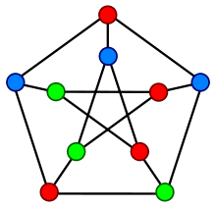
Example
Variables: Nodes Vi
Domain: Colors
Constraint: if Vi and Vj share an edge
Vi!=Vj
Notes:
‹#›

Slide 8
CSP
Solutions are an assignment of values to variables such that all constraints are true. May not require all variables being assigned i.e. scheduling with extra people
Find any solution or prove no solution exists
Notes:
‹#›

Slide 9
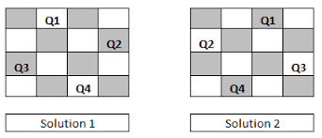
Example
4-Queens
Variables:
Domain:
Constraints:
Notes:
‹#›

Slide 10
Example
4-Queens
Variables: Q1,Q2,Q3,Q4
Domain:(1,1),...,(4,4)
Constraints:Queens cannot attack each other
For all i,j Qi[0]!=Qj[0] i!=j and Qi[1]!=Qj[1] i!=j and
|Qi[0]!-Qj[0]| != |Qi[1]!-Qj[1]|
Notes:
‹#›

Slide 11
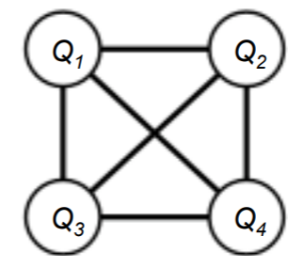
Constraint Graph
Binary CSP relates at most two variables
Constraint graph shows constraints
Can be exploited
Notes:
‹#›

Slide 12
Variables
Boolean
Discrete
Continuous
Notes:
‹#›

Slide 13
Constraints
Unary: Involving 1 variable and one value
Binary: 2 variables
Trinary…
Preferences: Become represented using costs and lead to constrained optimization problems
Notes:
‹#›

Slide 14
Real world CSPs
Scheduling
Hardware config
Amazon Scheduling
Floor planning
Notes:
‹#›

Slide 15
Using Search
Assume all variables are unassigned at the start
Slowly build up a solution by assigning a value
Goal test: all variables are assigned and no constraints were violated
This works to solve all CSPs!
Notes:
‹#›

Slide 16
Map coloring
Notes:
‹#›

Slide 17
Map Coloring
Variables: Nodes
Domain:{R,G,B}
Constraints: No adjacent nodes are the same color
Notes:
‹#›

Slide 18
Map coloring
Is this practical?
Notes:
‹#›

Slide 19
Map Coloring
Depth?
# of Variables
Branching factor?
Size of the Domain
Notes:
‹#›

Slide 20
Map Coloring
Depth?
# of Variables
Branching factor?
Size of the Domain
Can be reduced because the order in which we assign variables is irrelevant
Adding assignments can’t fix a broken constraint
Notes:
‹#›

Slide 21
Backtracking search
DFS applied to CSPs
Fix the order of variable assignment
Algorithm: repeat until a valid configuration is found
Select the next unassigned variable
Assign it an unexplored value from the domain
If an assignment was found proceed to the next variable
If no assignment could be found go back to the preceding variable and try a different value
Notes:
‹#›

Slide 22
Forward checking
Keep track of legal values for all variables
When assigning a value to the current variable update all other variables that share a constraint with the current variable
Quickly removes solutions that do not work
Solves n-queens to around 30 queens
Notes:
‹#›

Slide 23
Heuristics(Again)
We don’t need to search randomly, we can search down more promising paths
Variable assignment
Next variable choice
Ideas?
Notes:
‹#›

Slide 24
Heuristics(Again)
Two major families
Choose the least constraining value(Choice over domain)
Choose the most constrained variable(Choice over variables) or most constraining variable
Notes:
‹#›

Slide 25
Problem structure
Worst case complexity d^b
Many problems can be solved much more quickly
Some problems can be parallelized by disjointing the problem
Notes:
‹#›

Slide 26
This was a constructive approach
We don’t need to start from scratch
How did we do this for the traveling salesman problem?
Notes:
‹#›

Slide 27
Iterative algorithm
Start with a complete assignment but with values that do not satisfy the constraints
Re-assign variable values
Choose variables by which removes the most conflicts
Simulated annealing can be used here as well
Works amazingly well even for large state spaces
n=1024 for n queens
Notes:
‹#›

Slide 28
Summary
CSPs are common
Can be restructured as search problems
Can be solved by iterative improvements or construction methods
Notes:
‹#›

